Slide 1
MAPP Project Presentation

Slide 2
CONTENTS PAGE
AREA OF INTEREST
INTERVIEW
BRAINSTORMING PROCESS
PERSONA
IDEA SELECTION
CONCEPT SKETCH
BLOCK DIAGRAM
FLOW CHART
IMPLEMENTATION PLAN

Slide 3
AREA OF INTEREST
In this project, our primary area of focus and interest will revolve around...
ELECTRIC BICYCLE SAFETY SYSTEM

Slide 4
AREA OF INTEREST
WHY?
We have observed a concerning trend of injuries and accidents related to Electric Bicycles.
This issue has garnered attention not only in our community but also through widespread media coverage and on various social media platforms.
As a result, our project's primary objective is to explore innovative ways to enhance the safety of Electric Bicycles.

Slide 5
Interview
Interview Questions
Have you ever ridden an Electric Bicycle?
What are your thoughts regarding the safety of Electric Bicycles?
What types of safety systems or features do you believe should be integrated into Electric Bicycles to enhance their safety?
Do you think it is necessary for transportation authorities to further reduce the speed limit for Electric Bicycles? Why or why not?

Slide 6
INTERVIEW
RESPONSES
3/5 interviewees have ridden an Electric Bicycle before.
All of them believe that Electric Bicycle safety can be improved.
2/5 interviewees think that a speed control system should be implemented. The remaining 3 interviewees prefer the idea of a detection system, which would warn riders when they are about to collide.
4/5 interviewees think that the speed limit for Electric Bicycles should be further reduced. While remaining last interviewee suggests implementing harsher punishments instead of changing the speed limit.

Slide 7
BRAINSTORMING PROCESS
What will be the cost of making an Electric Bicycle safety system?
How will this product be feasible?
Will this product reduce the probability of someone getting hurt?

Slide 8
Persona
Mr. Chia, like many riders of Electric Bicycles, is deeply concerned about unintentionally exceeding the prescribed speed limits. According to the Land Transport Authority (LTA), the established limits are 25 km/h on shared paths and 10 km/h on footpaths. Exceeding these limits not only poses a risk to Mr. Chia but also endangers the safety of other road users. To address these concerns and prioritize safety for both himself and fellow riders, Mr. Chia is actively seeking a solution in the form of a dedicated safety device.

Slide 9
Ideas
Speed Measurement Device
2 Display 7 Segment to show speed limits in km/hr.
Blinking LED indicator when surpass specified speed limit
Buzzing sound when surpass specified speed limit

Slide 10
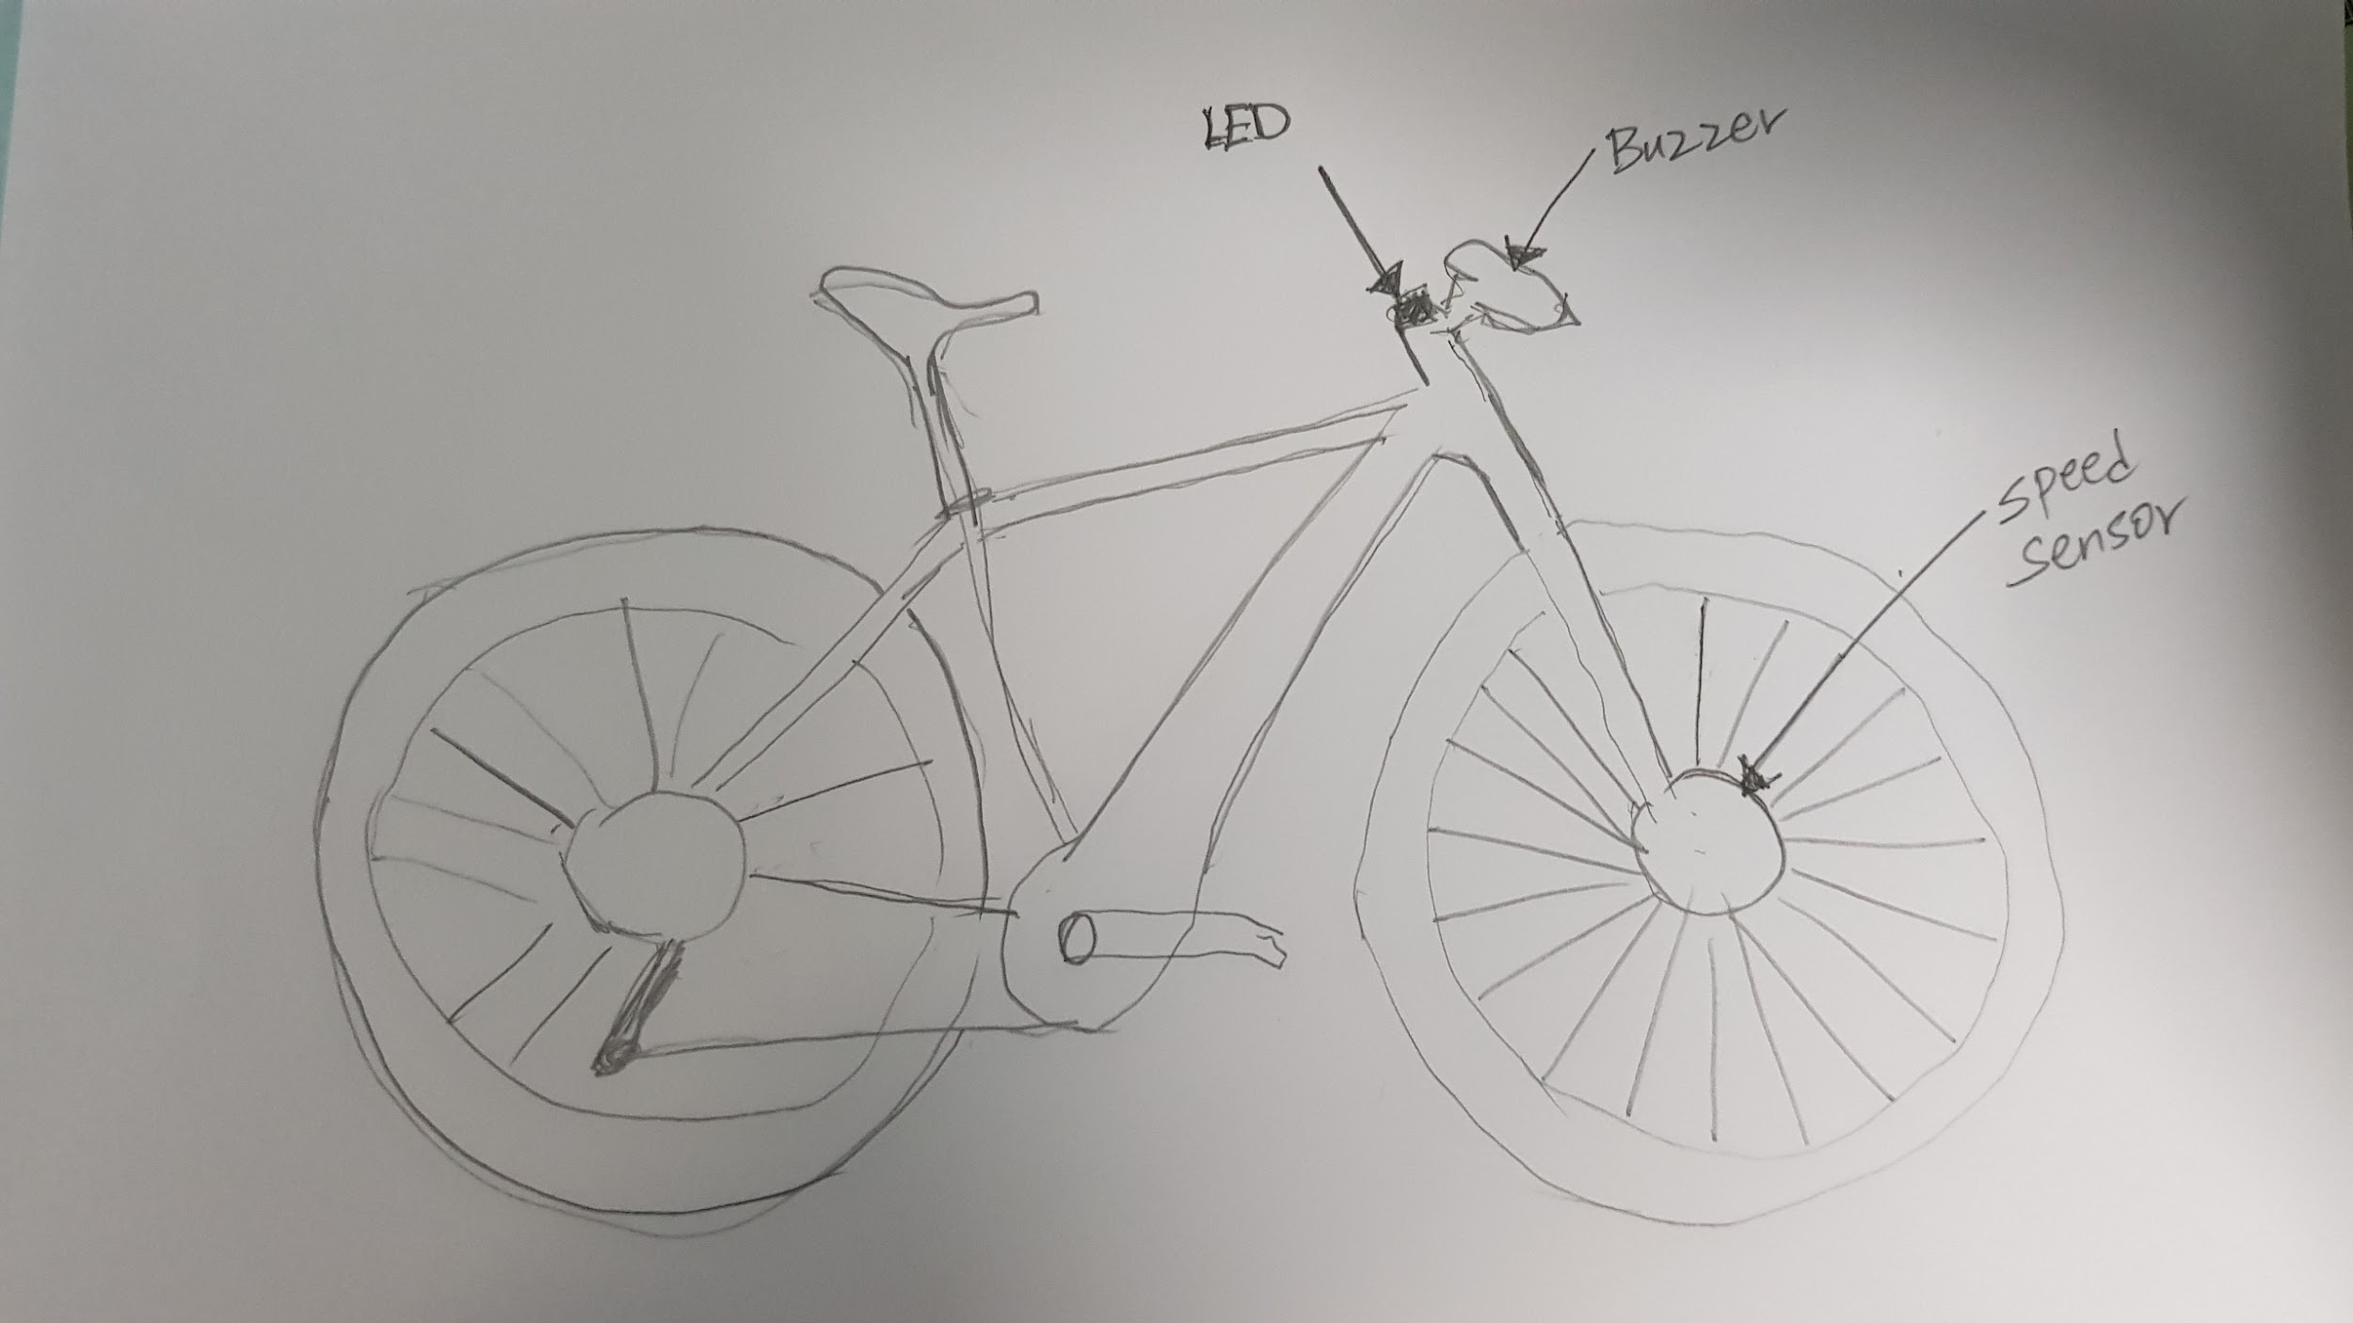
CONCEPT SKETCH

Slide 11
BLOCK DIAGRAM
PIC18F4550
BUZZER
Speed Sensor
7 Segment
LED

Slide 12
FLOW CHART
Start
Is the speed above the limit?
Speed Display
Speed Sensor
YES
Buzzer stops after 3 seconds
LED
NO
Is the speed still above the limit?
Buzzer
YES

Slide 13
IMPLEMENTATION PLAN
Vestibulum congue tempus
Vestibulum congue tempus
Circuit
Prototyping
Material Gathering
Troubleshooting
Gather necessary materials for the prototype
Design and code the circuit
Enhance circuit accuracy and resolve errors.
Test the safety system's accuracy and functionality on an E-scooter
1
1
2
2
3
4

Slide 14
THANK YOU.
THE END.

